Slide 1
PLAN PROPOSAL POWERPOINT
Student’s Name
Institutional Affiliation

Slide 2
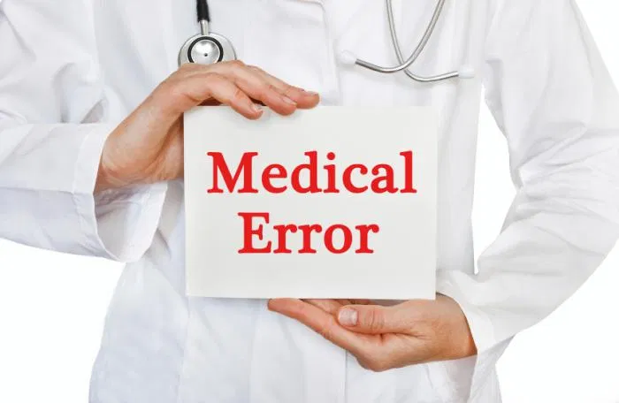
Patient Issue: Medical error
  Medical error involves the application of inappropriate strategies to attain certain health objectives.
  The most common types of medical errors include errors associated with administration of anaesthesia, delayed or missed diagnosis, infections acquired in hospitals, inadequate follow-ups, technical errors, or even delayed treatment (Tsiga, Panagopoulou, & Montgomery, 2017).
  These errors are likely to threaten the lives of the patients.
  Sources of these medical errors include communication challenges, inadequate flow of organizational information, human negligence, and patient-related aspects like inadequate assessment, and failure to acquire consent.
Notes:
Medical error involves the application of inappropriate strategies to attain certain health objectives. The most common types of medical errors include errors associated with administration of anaesthesia, delayed or missed diagnosis, infections acquired in hospitals, inadequate follow-ups, technical errors, or even delayed treatment (Tsiga, Panagopoulou, & Montgomery, 2017). All of these errors are likely to threaten the lives of the patient because any mistake in health practice might lead to a negative result such as death. Some of the sources of these medical errors include communication challenges, inadequate flow of organizational information, human negligence, and patient-related aspects like inadequate assessment, and failure to acquire consent.

Slide 3

Organizational Issue
  Several healthcare institutions experience challenges that revolve around human resource management and the entire working environment.
  The hostility of the working environment is an issue of consideration in this system.
  Some of the basis for assessing these hostilities includes race, religion, sex, disability, or even sexual orientation.
  Biases undermine the performance of these employees
  Another challenge facing this health organization is extensive workload that emerge as a result of shortage of workforce.
Notes:
Several healthcare institutions experience challenges that revolve around human resource management and the entire working environment. The hostility of the working environment is an issue of consideration in this system. Some of the basis for assessing these hostilities includes race, religion, sex, disability, or even sexual orientation. For instance, some healthcare workers have experienced racism since other employees from different races feel that they are not competent in their areas of specialization. Such biases undermine the performance of these employees hence leading to poor health care delivery. Another challenge facing this health organization is extensive workload. It is evident that this issue emerges as a result of a shortage of workforce. The ratio of nurses to the patient is not proportional since there are fewer nurses to handle many patients.

Slide 4

Why the audience should care about solving Organizational and patient issues
  The audience should care about solving patient issues, specifically those related to medication errors, to improve the quality of health care delivery.
  A continuous increase in medical errors reduces the trust of consumers in these health care institutions
  The act of caring also depicts that all stakeholders are in the frontlines of preventing future errors.
  Disclosure of medical errors triggers warnings and encourage the spread or diffusion of a culture of safe practice.
  The audience should also care about solving the challenge of a hostile working environment and the issue of extensive workload as a way of motivating all employees and improving their productivity.
Notes:
The audience should care about solving patient issues, specifically those related to medication errors, to improve the quality of health care delivery. A continuous increase in medical errors reduces the trust of consumers in these health care institutions; hence people might fail to seek health care services even in times of emergency. The act of caring also depicts that all stakeholders are in the frontlines of preventing future errors. Health care workers are able to engage in ethical practice after realizing their prior mistakes hence working towards improving their services. Research indicates that disclosure of medical errors triggers warnings and encourage the spread or diffusion of a culture of safe practice. Therefore, patient safety is a fundamental variable that every organization should put at stake. The audience should also care about solving the challenge of a hostile working environment and the issue of extensive workload as a way of motivating all employees and improving their productivity.

Slide 5

Relevance of an Interdisciplinary Team Approach
  An interdisciplinary team approach is relevant in this context because it improves leadership and management skills in an organization.
  The interdisciplinary approach is also relevant because it promotes person-centred practice.
  It is also relevant because it enhances the formulation of a standardized interdisciplinary care plan, thus promoting comprehensive person-centred care.
  The interdisciplinary team approach is also relevant because it fosters effective communication.
Notes:
An interdisciplinary team approach is relevant in this context because it improves leadership and management skills in an organization. Through this technique, the team is likely to adopt a clear vision and direction to enhance a positive atmosphere that values employee’s input and consensus.
The interdisciplinary approach is also relevant because it promotes person-centered practice. The integration of various teams is a mechanism that prioritizes the needs of all patients hence minimizing delays in service delivery. This approach also ensures that patients are involved in every aspect of care delivery hence empowering them to cooperate from the admission point to discharge time.
It is also relevant because it enhances the formulation of a standardized interdisciplinary care plan, thus promoting comprehensive person-centered care.
The interdisciplinary team approach is also relevant because it fosters effective communication. Communication is a crucial goal that determines the outcome of healthcare services. An interdisciplinary approach ensures that all stakeholders access adequate information and utilize it to improve their respective services. Through effective communication, an organization will definitely adopt a genuinely collaborative approach hence enhancing effective operations.

Slide 6

Interdisciplinary Plan Summary: Objectives
  One of the objectives of this interdisciplinary plan is to promote the training and retraining of employees.
  Another objective of this approach is to promote the culture of reporting.
  This technique also aims at improving the leadership skills of employees since they are able to interact with experts from respective fields.
  Moreover, this plan aims at reducing the workload by increasing the staff-to-patient ratio.
Notes:
One of the objectives of this interdisciplinary plan is to promote the training and retraining of employees. All employees should be retrained on contemporary issues that impact effective health care delivery. Training can help to improve workers’ skills in areas such as leadership and communication. Also, workers can learn how to accommodate co-workers from various cultures and those with different ideologies and beliefs.
Another objective of this approach is to promote the culture of reporting. This technique enables members of an institution to develop a culture of reporting any relevant information that is crucial in the health arena. Employees can also report any act of negligence they encounter in this working environment.
This technique also aims at improving the leadership skills of employees since they are able to interact with experts from respective fields. Effective leadership skills are fundamental in the healthcare sector because leaders in these organizations should influence followers, set goals, initiate actions, and also motivate all employees.
Moreover, this plan aims at reducing the workload by increasing the staff-to-patient ratio. The presence of adequate health care workers improves the ratio of patient to nurse or patient to doctor hence ensuring that these providers work with limits.

Slide 7

Interdisciplinary Plan Summary: Role of Interdisciplinary Team
  One of the roles is that it ensures that workers have shared roles and responsibilities in their respective team structures.
  The interdisciplinary team ensures that these individuals work towards accomplishing or achieving a common organization's goals (Ciemins, Brant, Kersten, Mullette, & Dickerson, 2016).
  Interdisciplinary teams are also in the frontline of conducting joint patient assessments and diagnoses.
  The interdisciplinary team will also ensure the presence of cohesiveness and creativity in this organization.
Notes:
One of the roles is that it ensures that workers have shared roles and responsibilities in their respective team structures. The interdisciplinary team ensures that these individuals work towards accomplishing or achieving a common organization's goals (Ciemins, Brant, Kersten, Mullette, & Dickerson, 2016).
Interdisciplinary teams are also in the frontline of conducting joint patient assessments and diagnoses. This role is important because it ensures that these procedures are accurate due to the presence of a pool of skills.
The interdisciplinary team will also ensure the presence of cohesiveness and creativity in this organization. For instance, such teams are likely to focus on the identification of mutual goals hence developing a sense of belonging. Therefore, there will be a greater level of innovation since people with specialized skills come together.

Slide 8

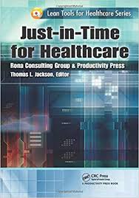
Implementation and Resource Management
  The plan can be implemented in a way that promotes visibility and accountability of every action.
  Accountability is an important issue that ensures that no resource is wasted or used for the undesired purpose (Bakalikwira et al., 2017).
  The organization can also ensure that it adopts a just-in-time model to enhance lean operation.
  Teamwork is another technique that can be integrated to ensure that resources are used accordingly.
Notes:
The plan can be implemented in a way that promotes visibility and accountability of every action. Accountability is an important issue that ensures that no resource is wasted or used for the undesired purpose (Bakalikwira et al., 2017). For instance, implementation of the plan must be accompanied by a thorough financial audit to enhance accountability and curb any case of misappropriation of funds.
The organization can also ensure that it adopts a just-in-time model to enhance lean operation. For example, only necessary or required resources should be utilized at a reasonable time. Therefore, all resources will be used appropriately.
Teamwork is another technique that can be integrated to ensure that resources are used accordingly. Based on teamwork, employees will be able to complete their tasks as soon as possible hence managing the time that is an essential resource in healthcare.

Slide 9

Evaluation
  Motivation is a criterion that is applicable in measuring the success of this plan.
  The prevailing workload is another variable used to measure the success of this plan.
  A reduction in medical errors also shows that the plan is successful.
Notes:
Motivation is a criterion that is applicable in measuring the success of this plan. This plan can be successful if all workers are motivated to work. A motivated employee will always try various alternatives to improve the health outcomes of patients.
The prevailing workload is another variable used to measure the success of this plan. This project can be successful if healthcare workers do not overwork to the extent that they experience burnouts.
A reduction in medical errors also shows that the plan is successful. A decrease in medical error implies that nurses or even doctors maintain a high level of compliance and accuracy in their duties hence improving health care delivery.

Slide 10
References
Bakalikwira, L., Bananuka, J., Kaawaase Kigongo, T., Musimenta, D., & Mukyala, V. (2017). Accountability in public health care systems: A developing economy perspective. Cogent Business & Management, 4(1), 1334995.
Ciemins, E. L., Brant, J., Kersten, D., Mullette, E., & Dickerson, D. (2016). Why the interdisciplinary team approach works: insights from complexity science. Journal of palliative medicine, 19(7), 767-770.
Tsiga, E., Panagopoulou, E., & Montgomery, A. (2017). Examining the link between burnout and medical error: A checklist approach. Burnout Research, 6, 1-8.

